Slide 1

Event Processing Course
Filtering and transformation
(Relates to Chapter 8)

Slide 2
Lecture outline
Filtering
Transformations
Derivations
FFT examples
Some code examples

Slide 3
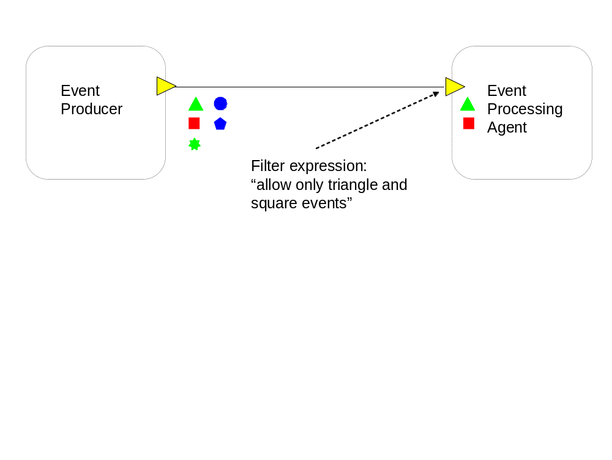
Filter on input terminal: by event type
A filter expression (assertion) takes the form of a predicate that is evaluated against an event.
The event passes the filter if the predicate evaluates to TRUE
and fails the filter if the predicate evaluates to FALSE[ .

Slide 4
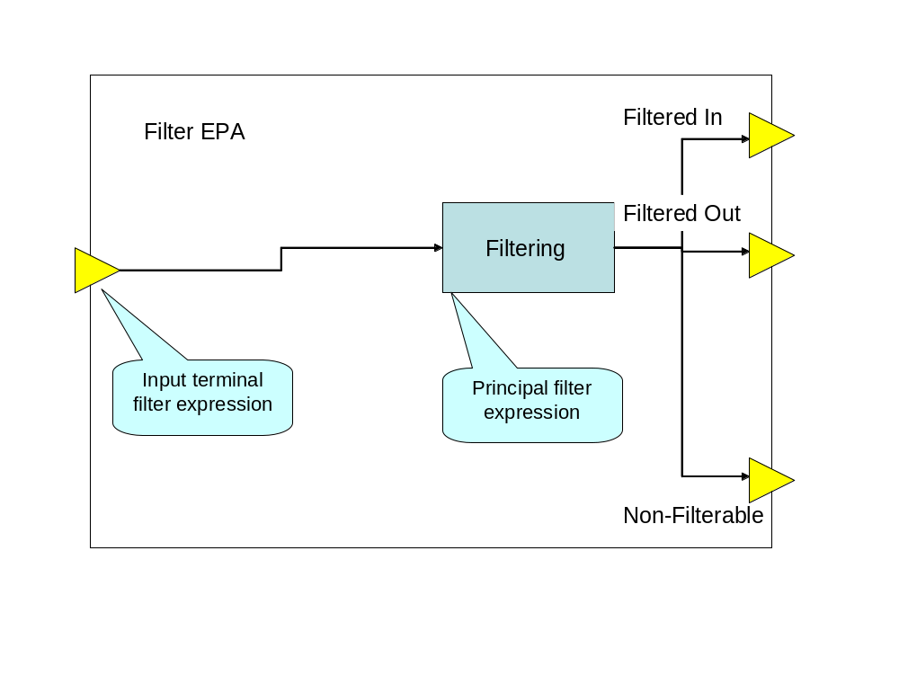
Filter EPA

Slide 5
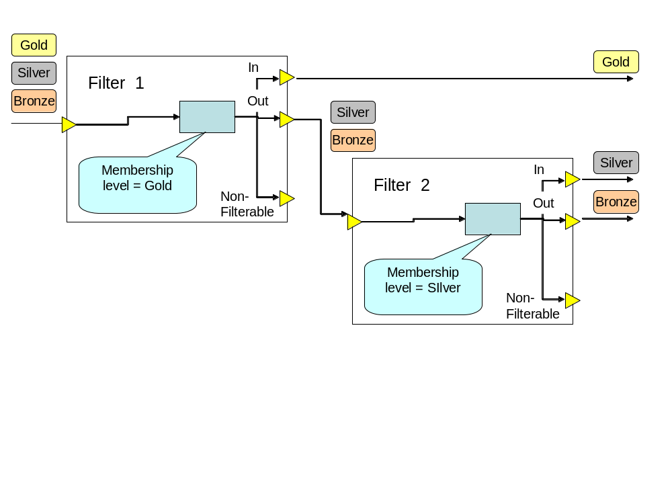
Two consecutive filters

Slide 6
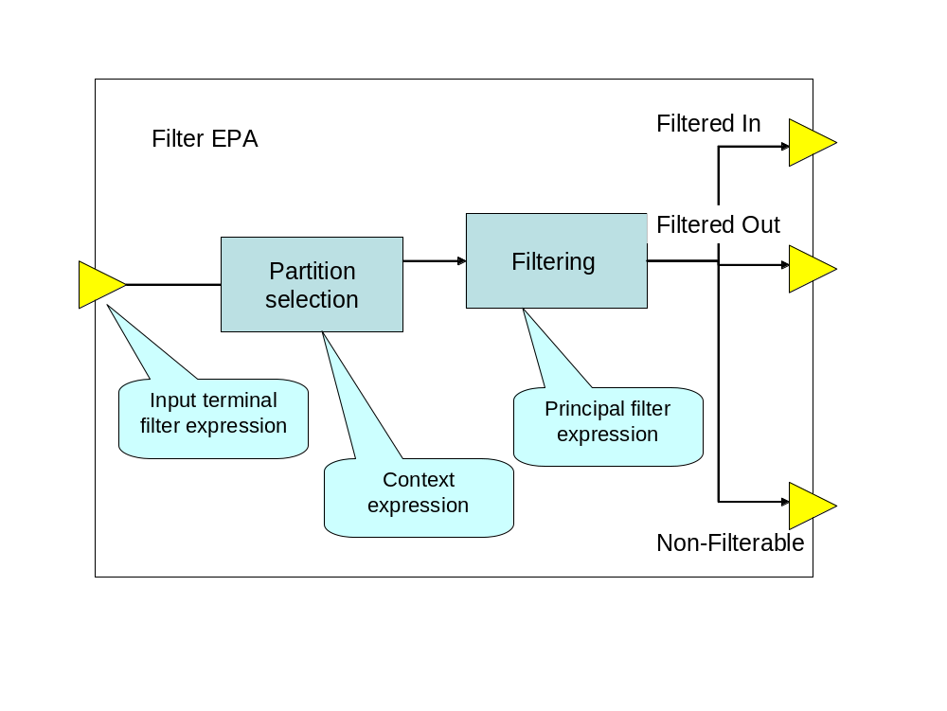
Various filtering

Slide 7
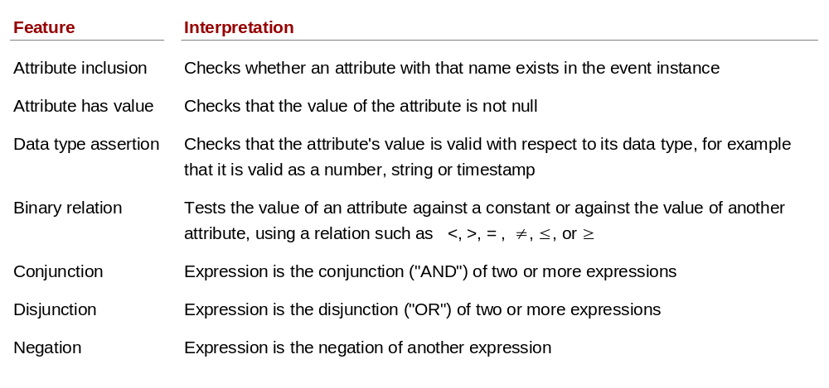
Filter features

Slide 8
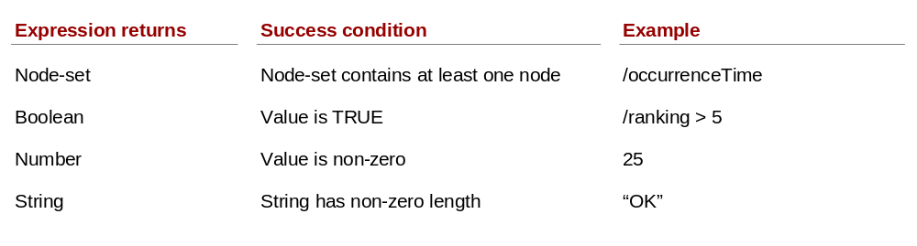
XPATH filters

Slide 9
Stateful filters
First m—This passes the first m event instances in the context partition window.
Last m—This passes the last (most recent) m event instances in the window.
Random m—This passes a random set of m instances.

Slide 10
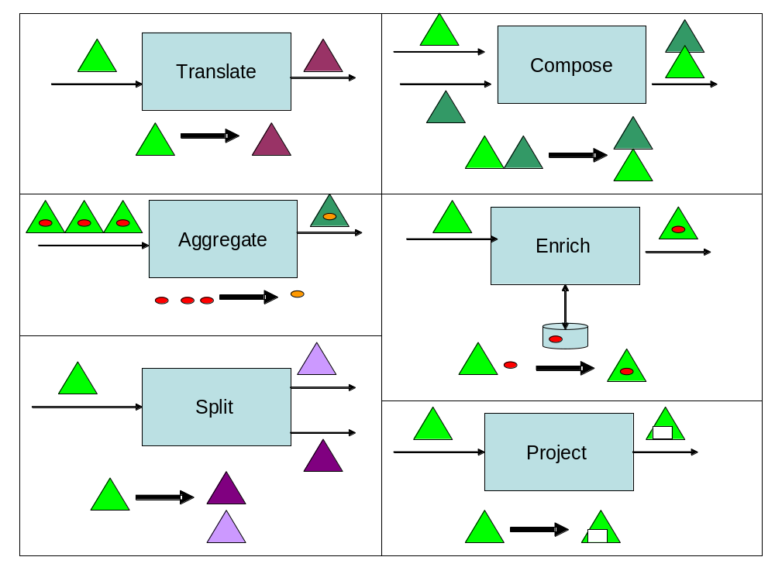
Transportation types

Slide 11
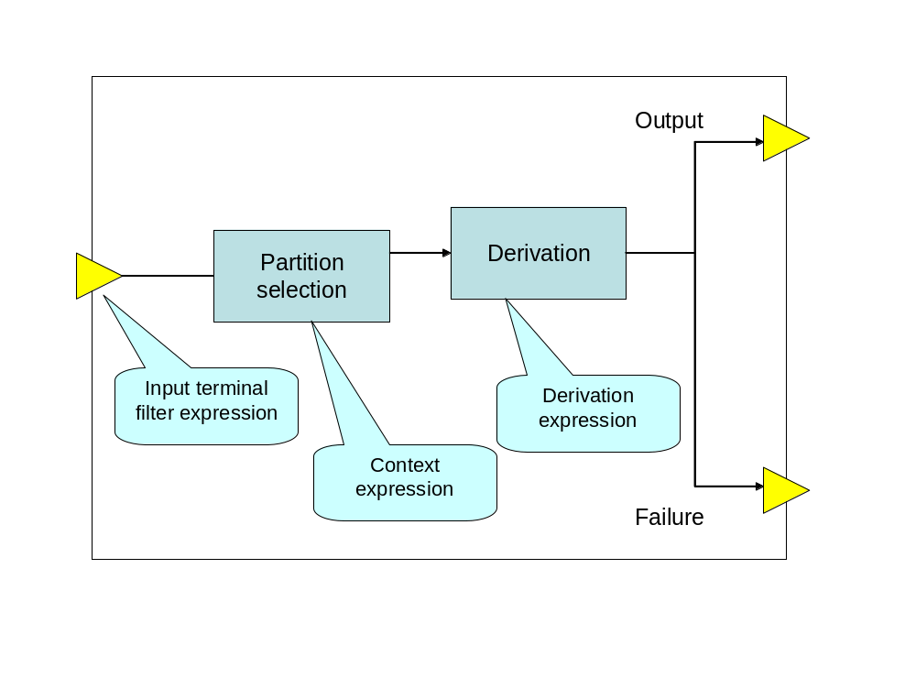
Transportation logic

Slide 12
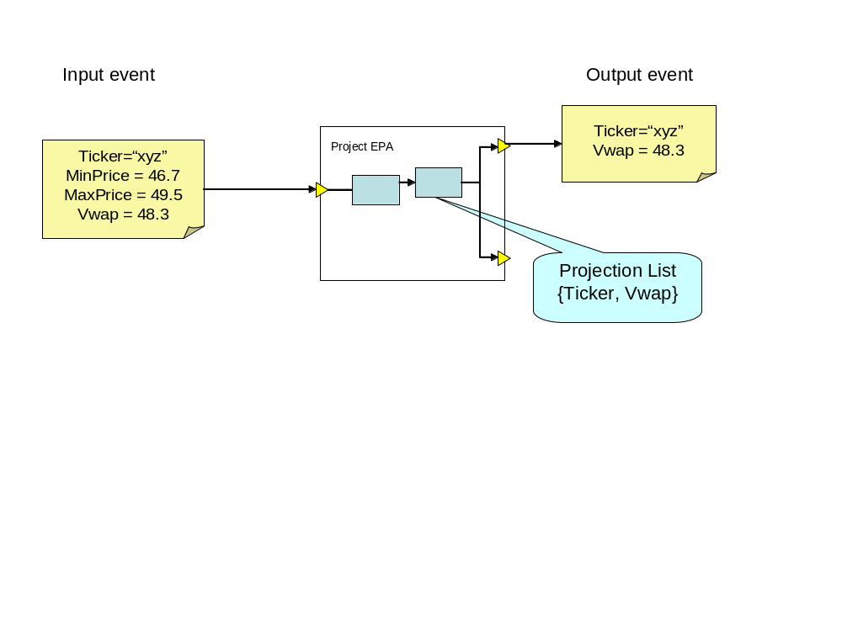
Project EPA

Slide 13
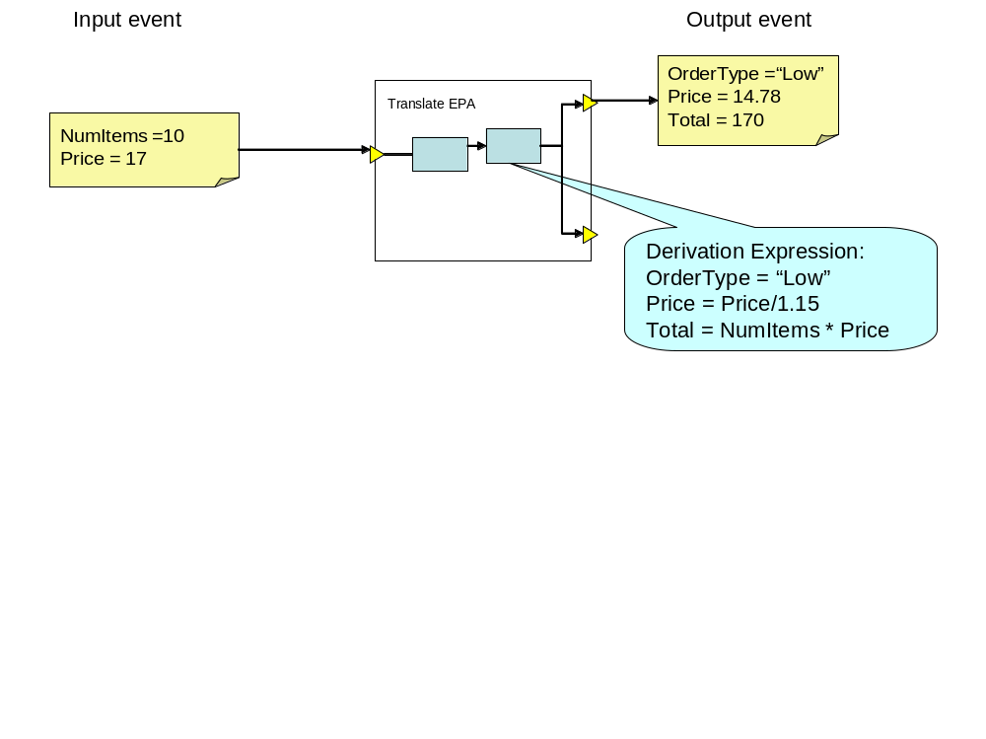
Translate EPA

Slide 14
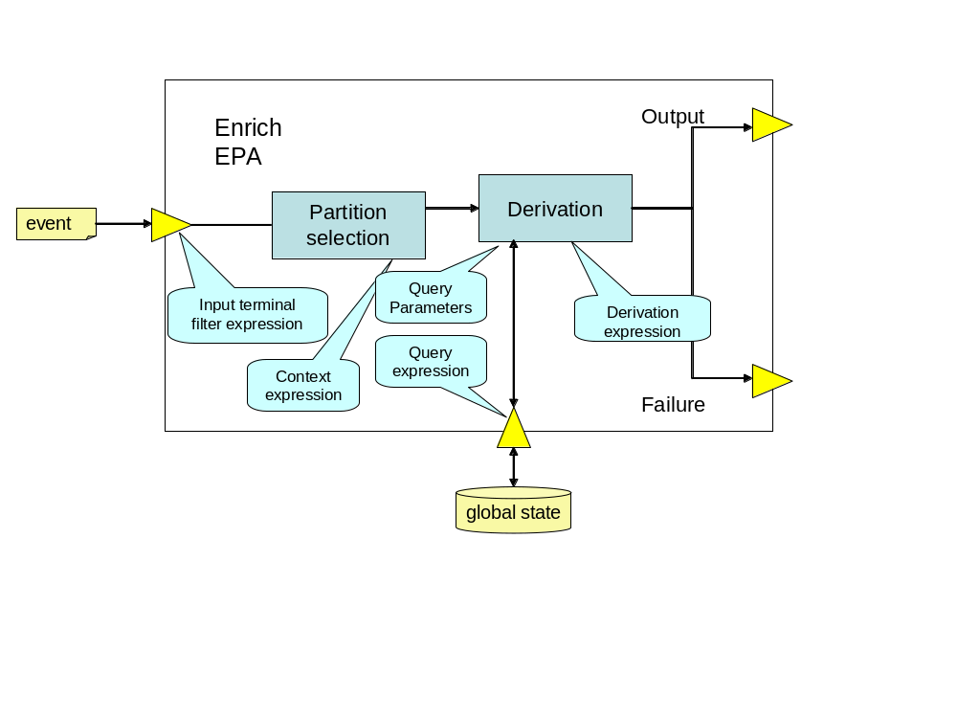
Enrich EPA

Slide 15
Multiple results policy for ENRICH
The multiple results policy defines the behavior of an enrich event processing agent when its query returns more than one result. The possible policy values are: first, last, every, and combine.
The four values for this policy are defined as follows:
First—Use only the first row that is returned.
Last—Use only the last row that is returned.
Every—A separate output event is generated, one for each row that is returned.
Combine—A single output event is returned, but the derivation rules have access to all the rows when preparing the output

Slide 16
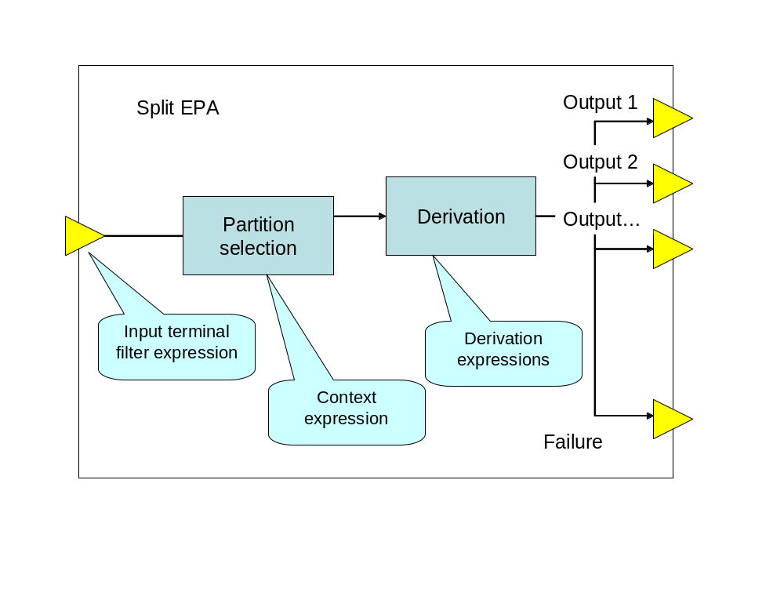
Split EPA

Slide 17
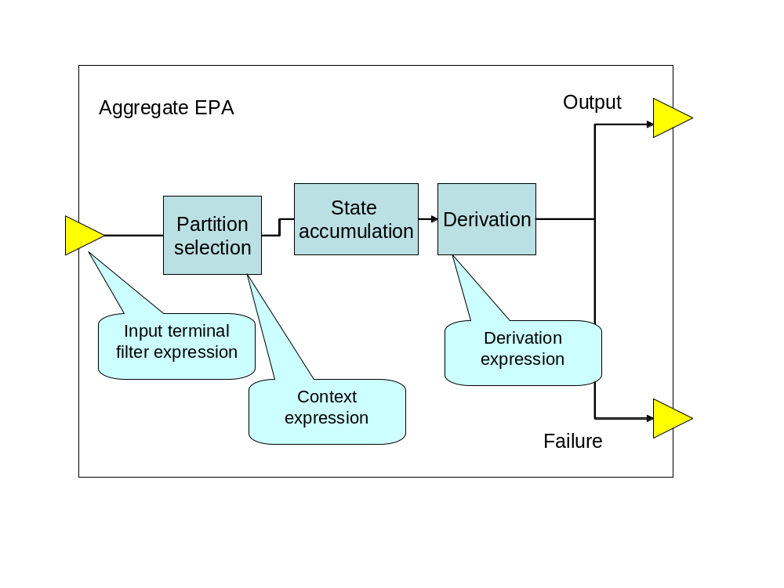
Aggregate EPA

Slide 18
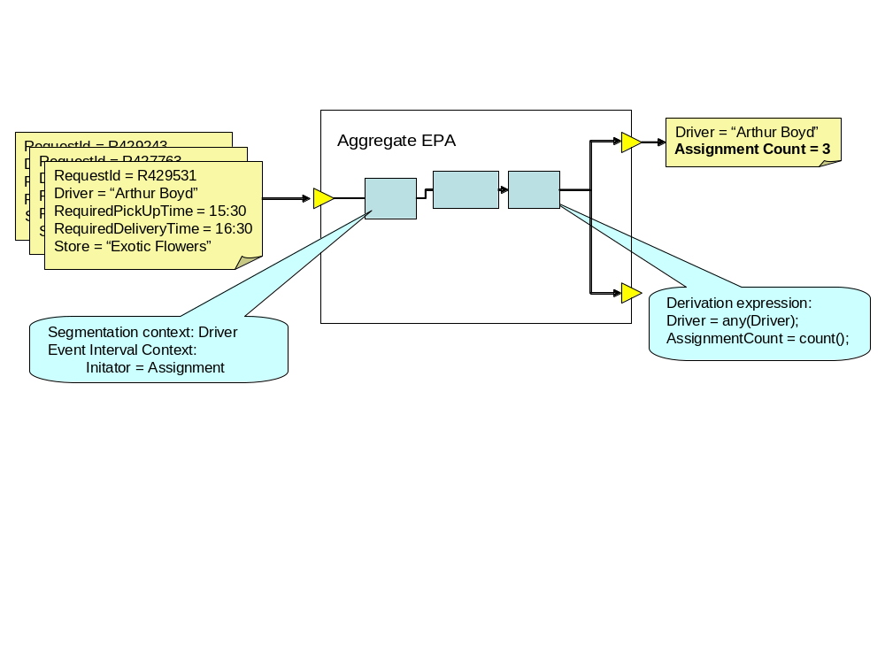
Aggregate EPA

Slide 19
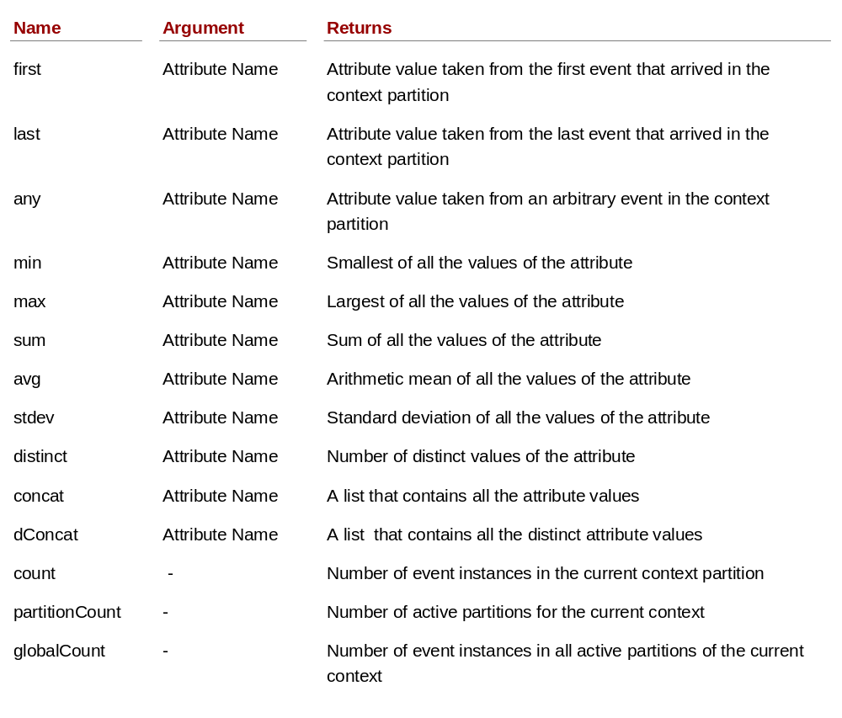
Aggregation operators

Slide 20
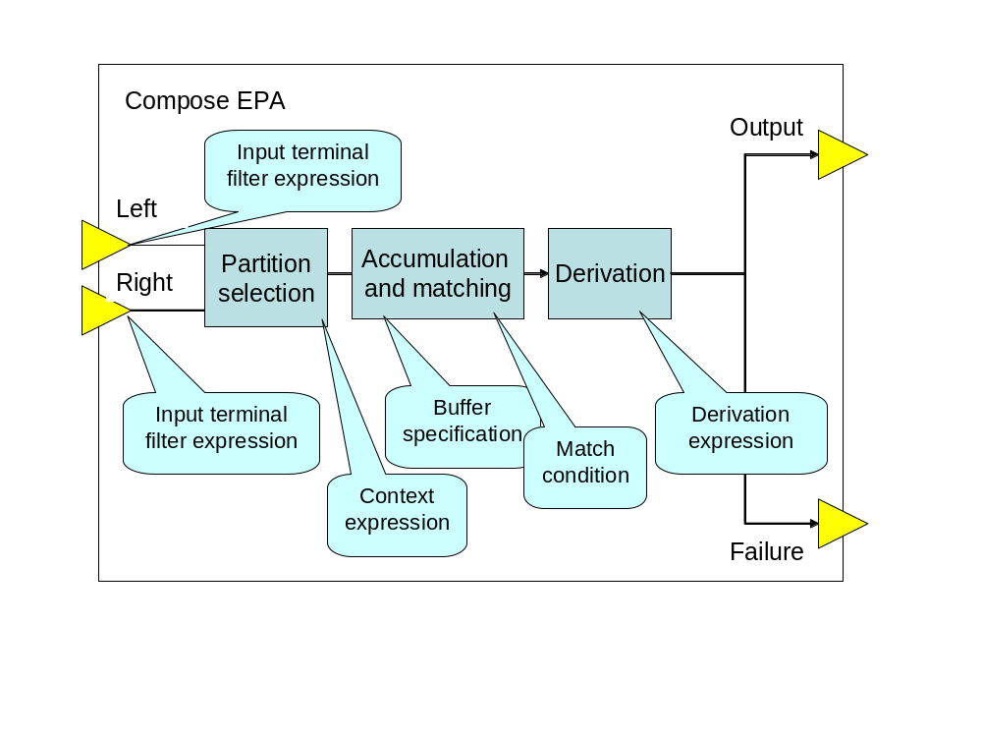
Compose EPA

Slide 21
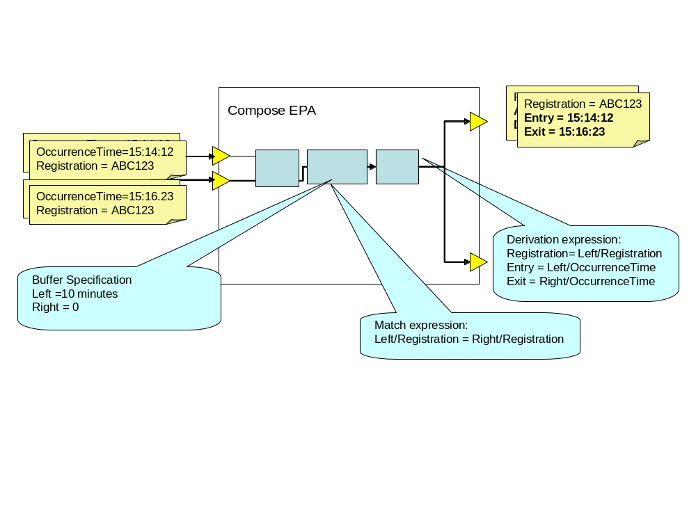
Compose EPA example

Slide 22
Compose policies
Left buffer specification—This controls how many event instances from the Left input terminal should be retained. It can be specified either as a count of instances or as a time interval.
Right buffer specification—This controls how many event instances from the Right input terminal should be retained. It can be specified either as a count of instances or as a time interval.
Unmatched Left Policy—This states what should happen when an event is evicted from the left buffer if that event hasn’t been matched with anything prior to eviction.
Unmatched Right Policy—This states what should happen when an event is evicted from the right buffer if that event hasn’t been matched with anything prior to eviction.
Match condition—This is the condition used to judge whether an event from the left stream matches one from the right stream. It can be a simple equality test, such as Left/A = Left/B, or a more complex expression involving both events, such as the XPath expression count(Left/A) = count(Right/B) + 7.

Slide 23
Derivation expression
A derivation expression is an expression that assigns values to the attributes of the derived event. A derivation expression can refer to values of the input event attributes.

Slide 24
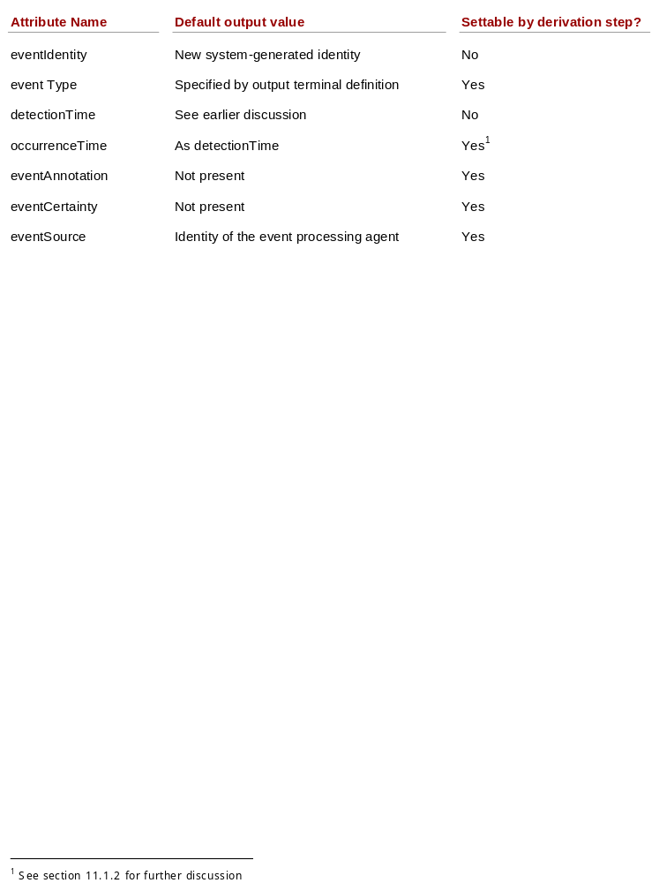
Header derivation

Slide 25
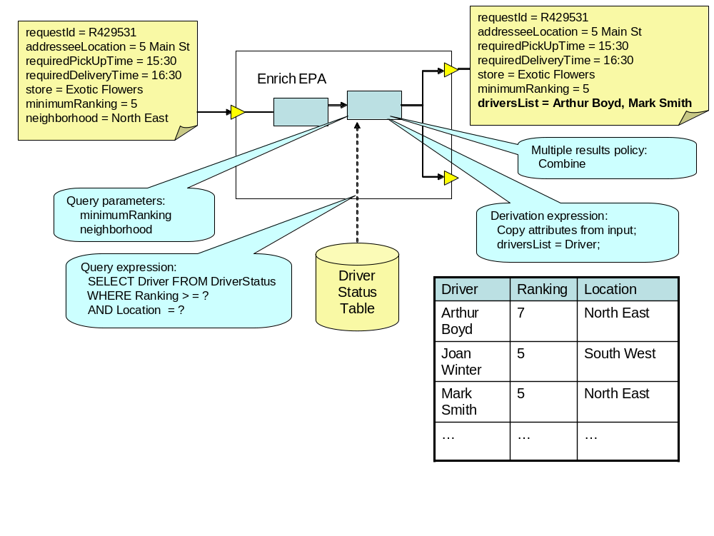
FFD – Bid Request Creator EPA

Slide 26
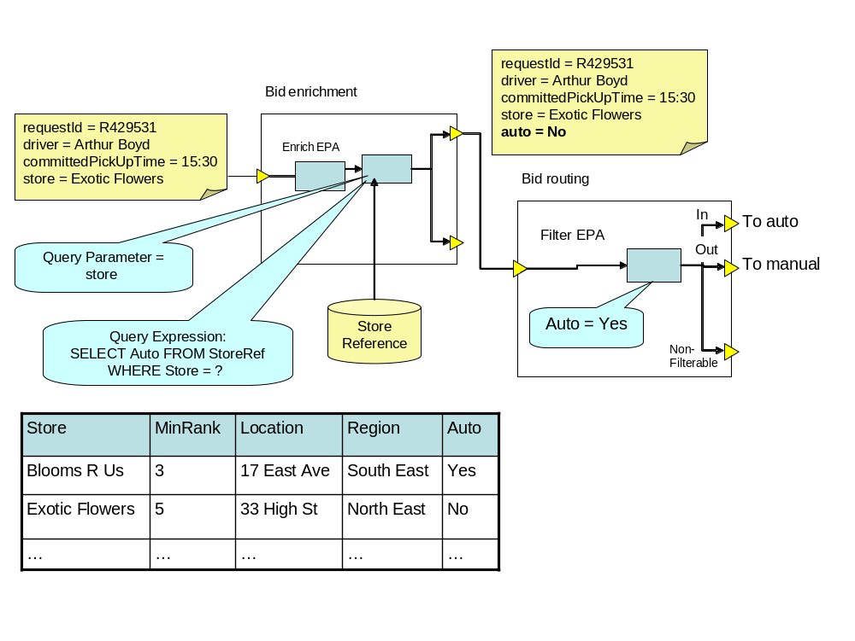
FFD – Bid Enrichment

Slide 27
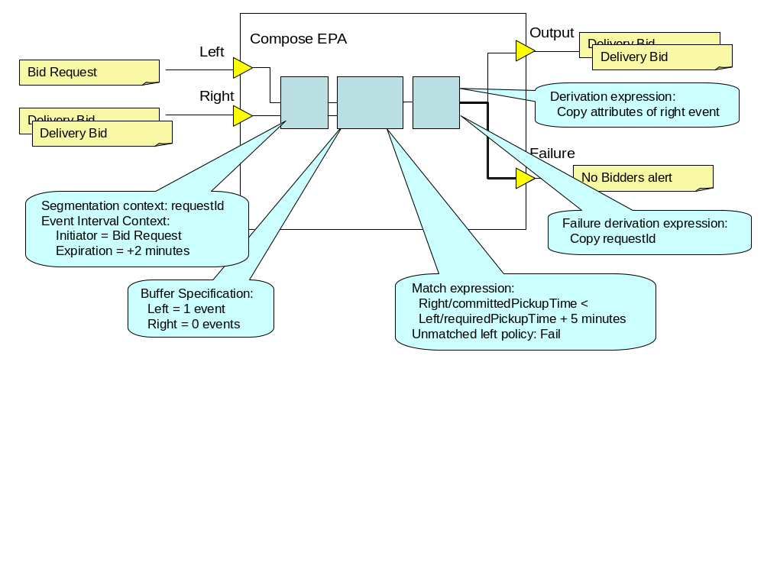
FFD - Assignment manager EPA

Slide 28
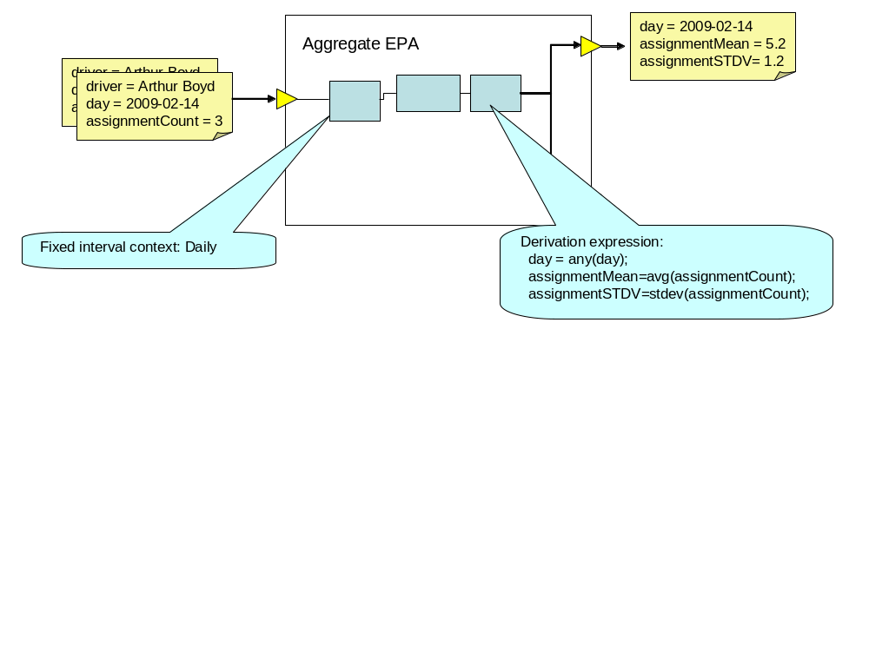
Daily Statistics Creator

Slide 29
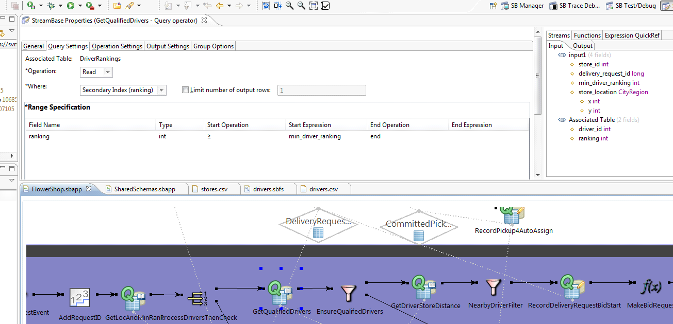
Streambase example

Slide 30
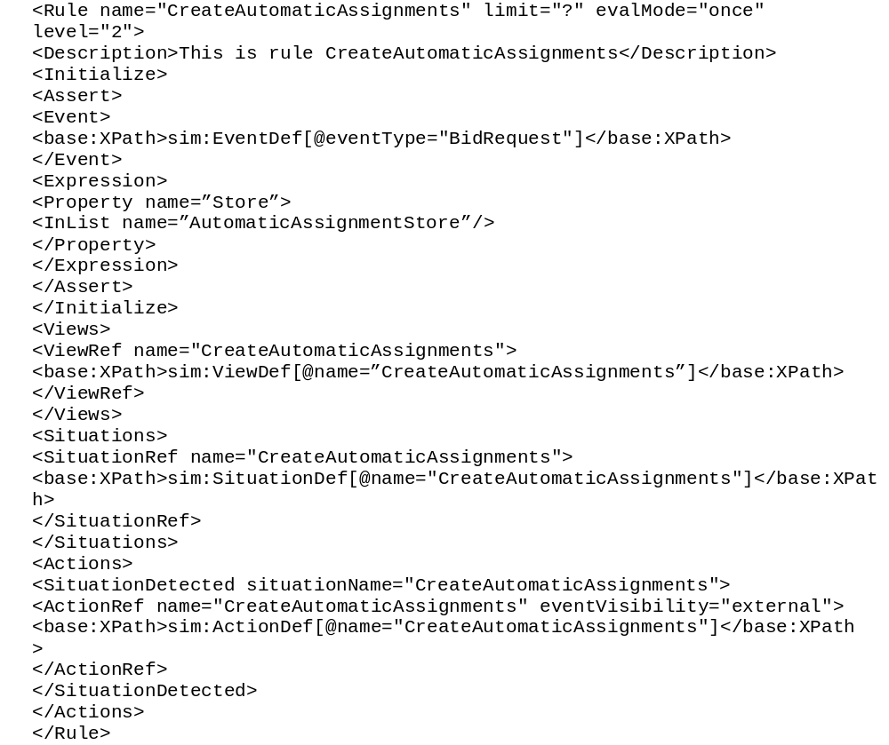
Rulecore example

Slide 31
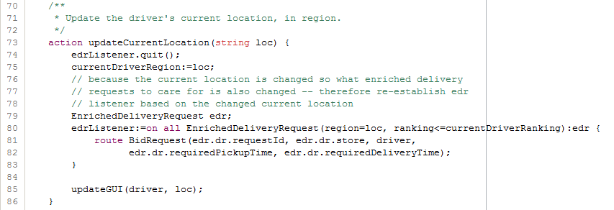
Apama example

Slide 32
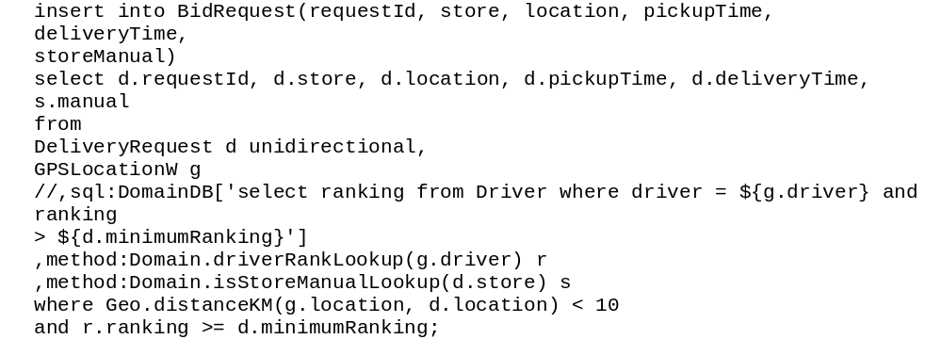
Esper example

Slide 33
Lecture summary
In this lecture we have looked into:
Filtering
Transformation types
Aggregation derivations
Some code examples

